Slide 1



COMING TO THIS SCHOOL ON …..
SIGN-UP SHEET
FOR
EARLY-BIRD
BULK DISCOUNTS
30%
Book 1: ‘An Inspirational Story... Henry is a gentle man of God who has faced life’s great mountains…’
Bear Grylls

Slide 2
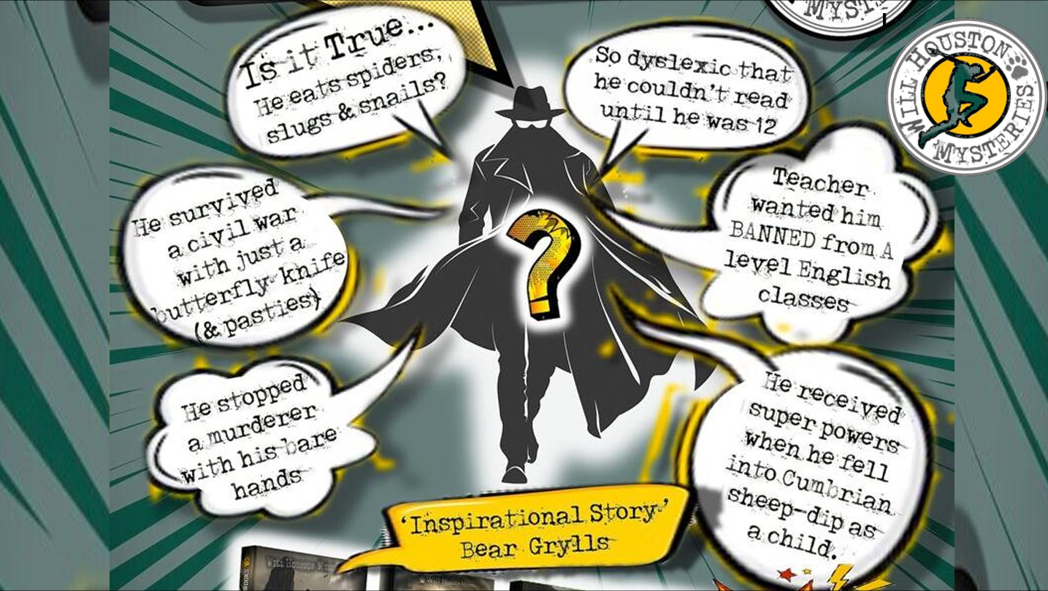

Slide 3

GAMES WITH PRIZES

Slide 4

ON THE DAY

